Slide 1


Robot Control via Compact LLMs
Bogdan Oprisiu — supervised by Conf. Dr. Christian Săcărea
Babeș-Bolyai University, Faculty of Mathematics & CS
SCSS Conference 2025

Slide 2
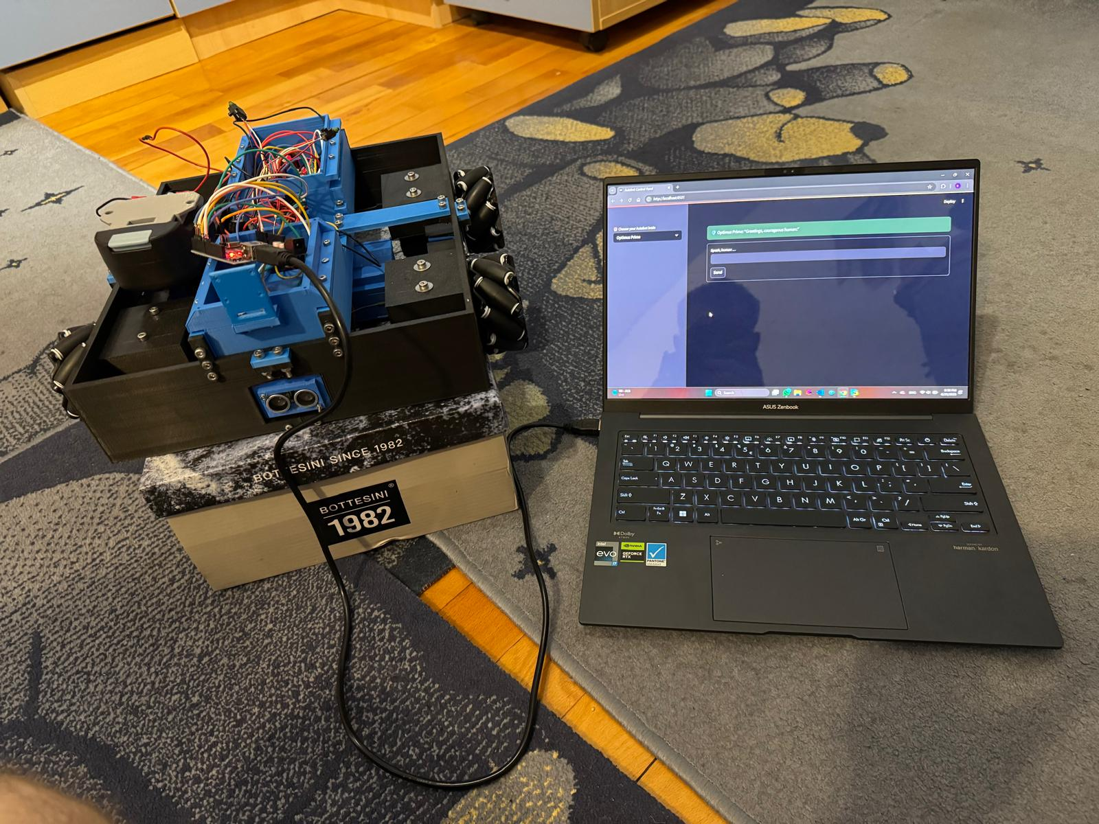
Why Compact On-site LLMs
Real-time control — 32 ms vs 120 ms cloud
Works offline — no network, no downtime
Fits in < 3 GB RAM — Pi-ready
Zero API fees & full data privacy

Slide 3
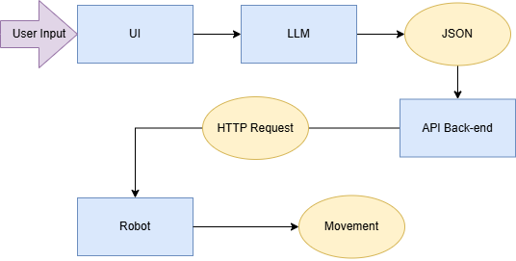
System at a Glance

Slide 4
Dataset
Split | Size (Pairs) | Label Source
Train - labelled | 64 068 | Template engine
Train - pseudo | 153 742 | Teacher LLM
Test | 1032 | Hand-curated
64 k labelled pairs – templates × synonyms → exact JSON
154 k unlabeled pool – scraped + GPT paraphrases + synonym/number augmentation
1 k curated tests – by myself

Slide 5
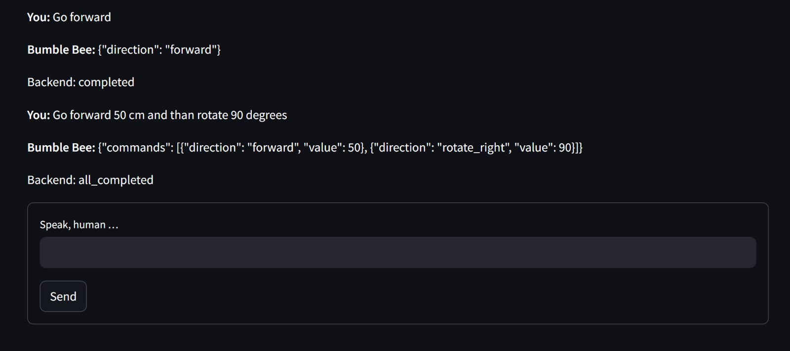
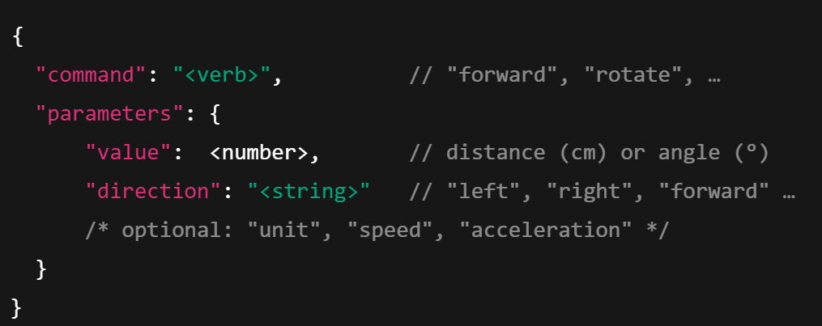
Command structure
Json Schema
Current Model Output

Slide 6
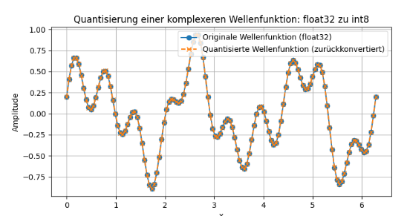
Quantization
32-bit → 8-bit weights & activations - same math, 4× smaller model
Dynamic int8 in PyTorch - one-line post-training step
Result: VRAM 11 GB → 2.9 GB,
< 1 % accuracy drop

Slide 7
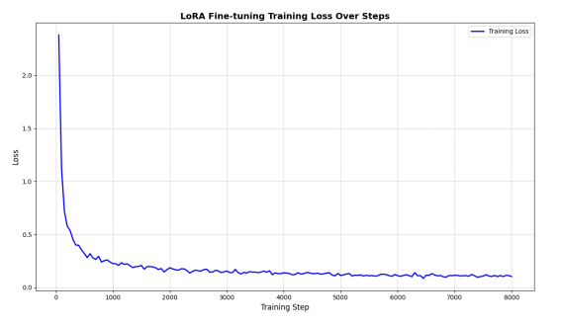
Lora
Keep base weights frozen, learn a tiny patch W′ = W + B ⋅ A (rank r ≪ d,k)
Rank 8, α 16 adapters → only ≈ 0.5 % of weights are trainable 4 × lower memory, minutes to converge, < 1 % accuracy drop
Loss curve on right shows rapid fall from 2.3 → 0.1 in < 8 k steps

Slide 8
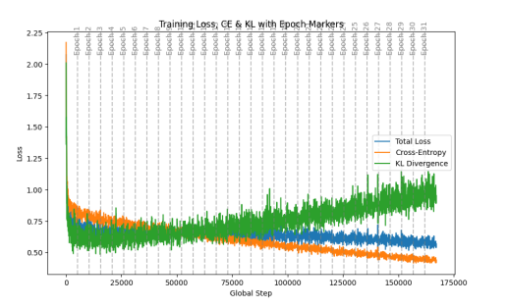
Main Results
Dynamic loss mix start w KL = 0 .40 → 0.25 (linear anneal), CE weight grows from 0.60 → 0 .75
Training pattern CE steadily ↓ (model hits hard JSON labels) while KL fluctuates ↑ as it becomes less dominant
Healthy divergence expected as the student “graduates” from the teacher
End result Mini-T5 (42 M, int8) reaches 92 % EM in 12 epochs, fits in 1.1 GB, 32 ms latency

Slide 9
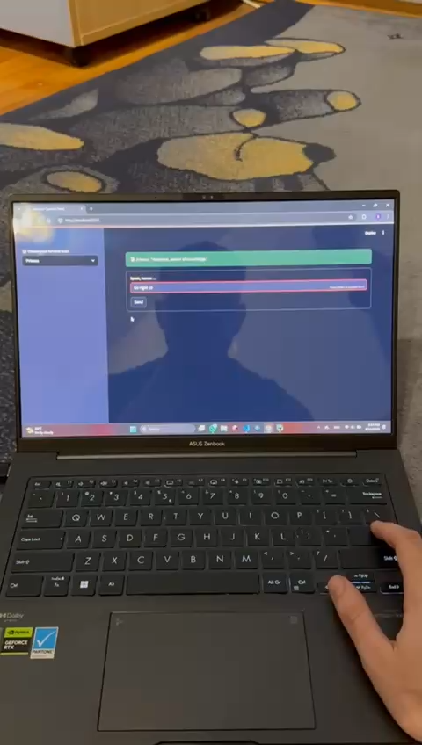
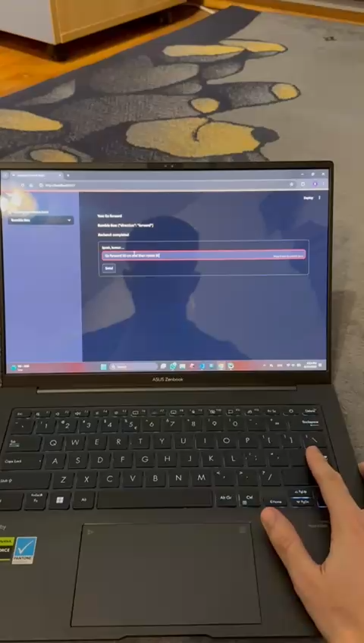
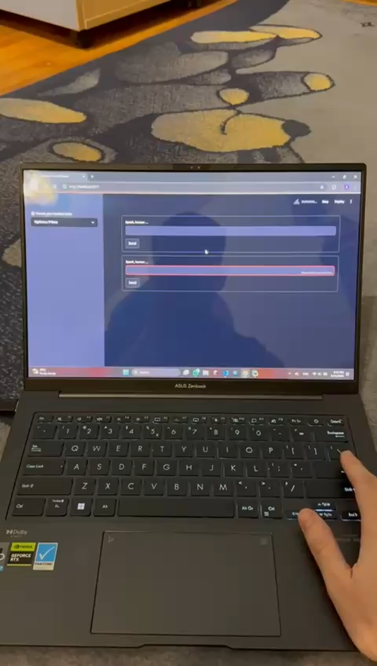
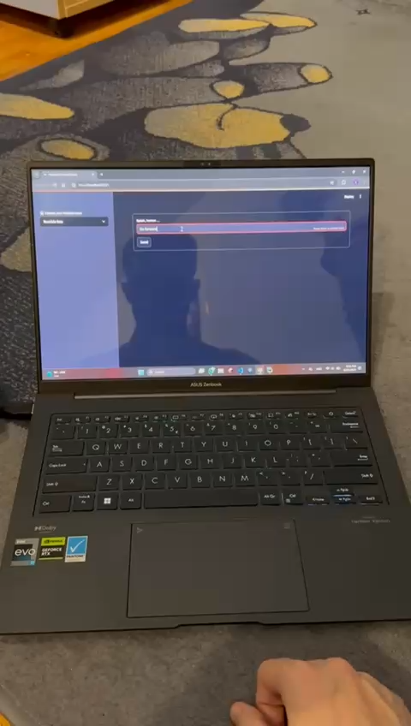
Demo

Slide 10
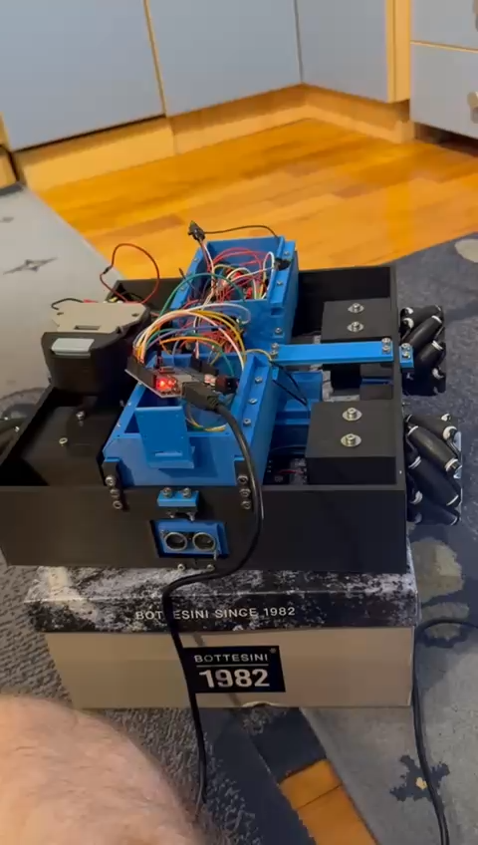
limitations
External host needed
– model still runs on a laptop, not on-board
Numeric fragility
– occasional unit / number mis-parses
Synthetic-heavy training data
– limited real user phrasing diversity
No sensor feedback loop
– Sensors are only simulated
Reduced command set
– acceleration, curves, complex paths missing

Slide 11
Lessons, takeaways & Future Work
Goal reached – Model Translates command into robot movement
Key lesson – smart data engineering + lightweight compression can rival a “bigger model” in specific edge cases.
Take-away – most bugs came from dirty text, not model capacity.
Still missing – true on-board inference
Next steps:
port student model to Pi
collect richer, real commands
plug in ultrasonic array and camera → language-in-the-loop sensor fusion
explore light RL-HF (“thumbs-up/down”) to harden against out-of-domain inputs

Slide 12

“AI is the new electricity”- Andrew NG

